Slide 1


Python Mini Project
Dice Rolling
Devika.k.s
22BTRSN012
CSE-SE

Slide 2

Objective:
Writing a program to roll a die and display the numbers rolled to the user.

Slide 3

Algorithm
Step 1: Start.
Step 2: Defining a class ‘dice’ .
Step 3: Defining a function ‘roll’ to roll the dice as per the user’s inputs, and print the output using random function to get the die values. If the user wishes to roll another set of dice, they can by entering 1 to continue and 0 to exit.
Step 4: Taking values from the user and checking the validity of the inputs. If it is not valid, the user can input the values again or exit the code by entering 1 or 0 respectively, and calling the ‘roll’ function using the object created.
Step 5: Stop.

Slide 4

Code
import random
class dice:
def roll(self, row, column):
for i in range(1, column + 1):
print("D%d" % i, "", end="\t|\t")
print()
for i in range(row):
for j in range(column):
print(random.randrange(1, 7), end="\t|\t")
print()
print(" To roll again type 1, to exit type 0")
while True:
a = int(input('Input how many times you want the dice to be thrown : '))
b = int(input("Input how many dice do you wish to throw : "))
if (a >= 10):
print("The number of times you want to throw the die cant be greater than 10. Please enter a number lesser than 10")
print(" To Enter the values again type 1, to exit type 0")
elif b >= 10:
print("The number of die to be thrown, cant be greater than 10. Please enter a number lesser than 10")
print(" To Enter the values again type 1, to exit type 0")
else:
obj = dice()
obj.roll(a, b)
c = input()
if c == '0':
break

Slide 5

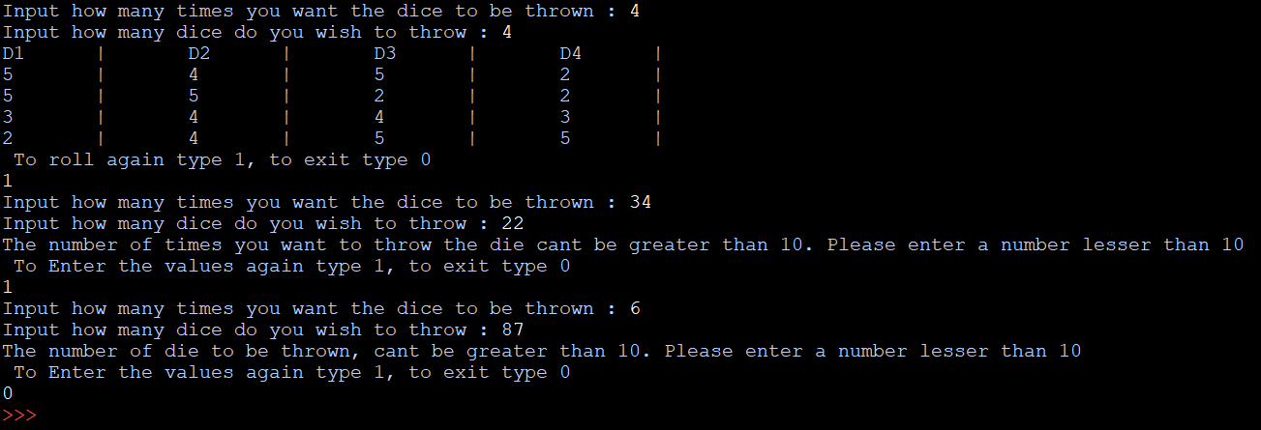
Output

Slide 6

Conclusion
This simple code with the use of random module generates random numbers between 1 and 6, which can be interpreted as rolling a dice. With the use of nested loops we can also simulate multiple dice being thrown multiple times.

Slide 7
THANK YOU!

